Slide 1
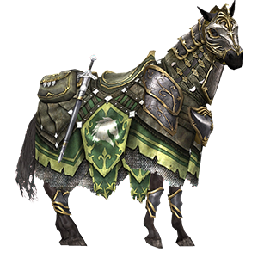
“The horse is made ready for the day of battle,
but the victory belongs to the Lord.”
Proverbs 21:31

Slide 2
We must prepare for the battle.

Slide 3
We must fight in the battle.

Slide 4
If we end up fighting against the Lord, we will lose.

Slide 5
Though our preparation and fighting cannot actually prevail, we will win.

Slide 6
When we win, we must give God the thanks and the glory.

Slide 7
“The horse is made ready for the day of battle,
but the victory belongs to the Lord.”
Proverbs 21:31

